Slide 1
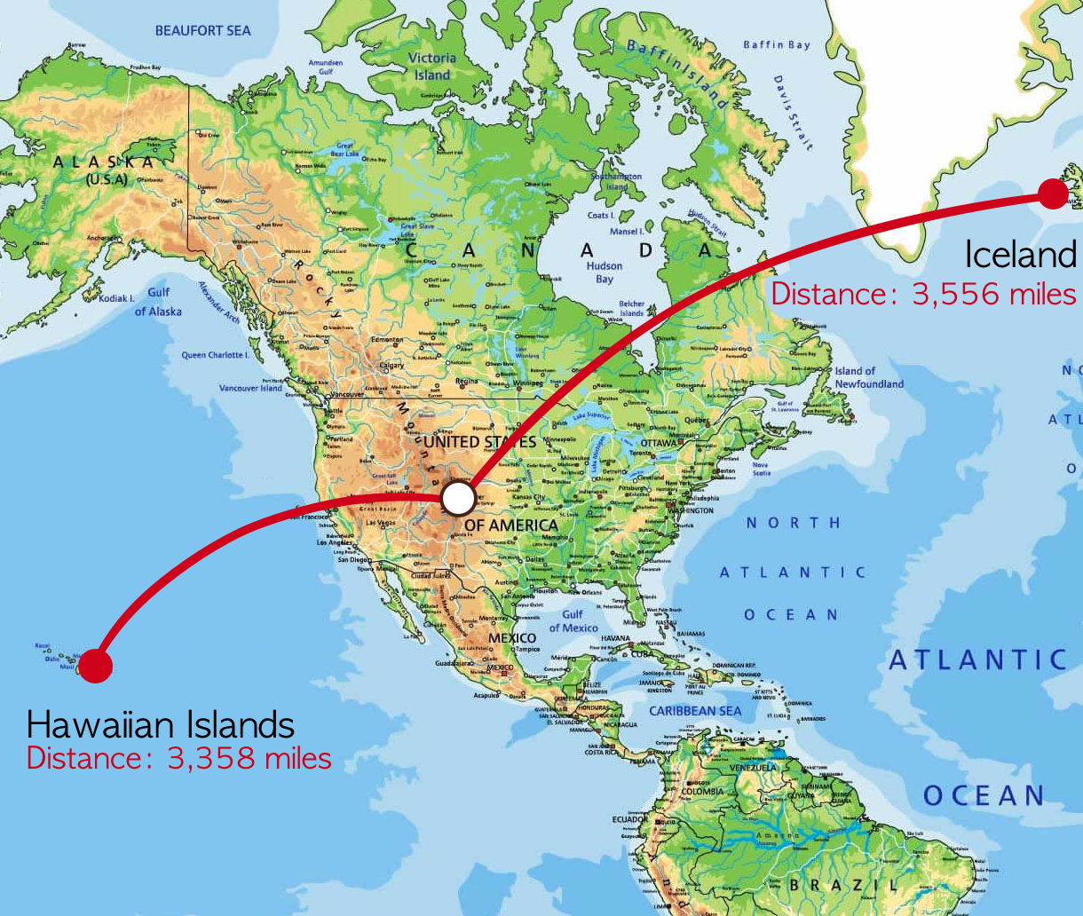
Local Farm-raised Fish is More Sustainable than Wild-caught Fish Imported to Colorado
Jared Valesano
Zoology
Colorado State University
Environment Impacts from Importing Wild-caught Fish
As millions of fish are imported and distributed to land-locked states all over the U.S., many people do not recognize the underlying factors that provides seafood to fulfill their desires. The modes of transportation to deliver seafood products entail devastating consequences to the environment. With aircraft and automotive vehicles requiring the burning of fuels, greenhouse gasses are emitted at unprecedented rates. With the exhaust emissions increasing the concentrations of CO_{2,} NO_{x,} and hydrocarbons in atmosphere and in turn the tropospheric ozone, surface temperature and toxicity to living organisms increases (Johnson et al 1992). This surface temperature increase influences the overall global climate, directly affecting weather events, atmospheric and oceanic circulation, and plant and animal life.
This figure illustrates the geographical distribution of surface air temperature warming as a result of the increase in greenhouse gas concentrations (Mitchell 1989).
Not only is the drastic change in climate an environmental concern, the altering of the stability of natural ecosystems by species removal can create negative consequences as well. One of the main causes for the collapse of an ecological community is overfishing, preceding anthropogenic pollution and climate change (Jackson et al 2001). Species like yellowfin tuna and Atlantic cod play important roles in their community. Overfishing these species causes a chain reaction across the food web, limiting the survival of predator species that feed on them. The loss of predators can lead to overcrowding or disappearance of other species, ultimately affecting species richness in the ecosystem.
This figure portrays the distance the Pacific yellowfin tuna and Icelandic Atlantic cod travel to reach Colorado. Just two species of the many that are imported across ocean basins to reach the United States.
Sustainable Alternatives to Imported Fish
The cost of transportation of imported wild-caught fish is very high. Increasing exhaust emissions continually proves to be detrimental to the overall climate, and the removal of wild species from their habitats has the potential to greatly alter or even collapse an ecosystem. In providing local alternative species for land-locked states, society is presented the opportunity to reduce anthropogenic consequences to the environment. People desire red meat fish like yellowfin tuna (ahi tuna in sushi) or white meat fish like Atlantic cod (fish and chips), so these species must be flown around three thousand miles to Colorado. As natural resources are being use at 50 times the replenishable rate, local aquaculture allows for environmentally sustainable seafood to be produced for markets (Hixon 2014). A beneficial alternative for red meat fish is farm-raised salmon produced at a land-based fishery. This salmon still provides an excellent source for omega-3 fatty acids and even can be a third of the price of wild-caught salmon (Santerre 2010). As an alternative to white meat fish like cod, the Colorado Hybrid Striped bass is one of the only fish that can taken from the fishery and put on a consumer’s plate in 24 hours. Pure artesian water is used in a Colorado Striped bass fishery, and then recycled to irrigate crops, proving to be very sustainable. By providing local farm-raised fish to consumers in Colorado, there is the potential to change our impact on climate change and to maintain healthy, natural ecosystems.
Why is a switch to local seafood important?
The purpose of this announcement is to bring attention to the environmental impacts consuming seafood that is imported thousands of miles to Colorado has. It has never been so important for society to change the habits that lead to climate change, as it poses a threat to all living organisms. By switching to local farm raised fish, Coloradans can decrease negative environmental impacts while still receiving comparable nutritional benefits that are seen in wild caught fish imported to Colorado.

Slide 2
References
Hixson, S. M. (2014). Fish nutrition and current issues in aquaculture: the balance in providing safe and nutritious seafood, in an environmentally sustainable manner. Journal of Aquaculture Research and Development, 5(3).
Jackson, J. B., Kirby, M. X., Berger, W. H., Bjorndal, K. A., Botsford, L. W., Bourque, B. J., ... & Hughes, T. P. (2001). Historical overfishing and the recent collapse of coastal ecosystems. science, 293(5530), 629-637.
Johnson, C., Henshaw, J., & Mclnnes, G. (1992). Impact of aircraft and surface emissions of nitrogen oxides on tropospheric ozone and global warming. Nature, 355(6355), 69-71.
Mitchell, J. F. (1989). The “greenhouse” effect and climate change. Reviews of Geophysics, 27(1), 115-139.
Northeast Seafood. (n.d.). Retrieved from https://northeastseafood.com/
Products. (n.d.). Retrieved from https://www.seattlefish.com/products/
Santerre, C. R. (2010). The risks and benefits of farmed fish. Journal of the World Aquaculture Society, 41(2), 250-257.

